Slide 1


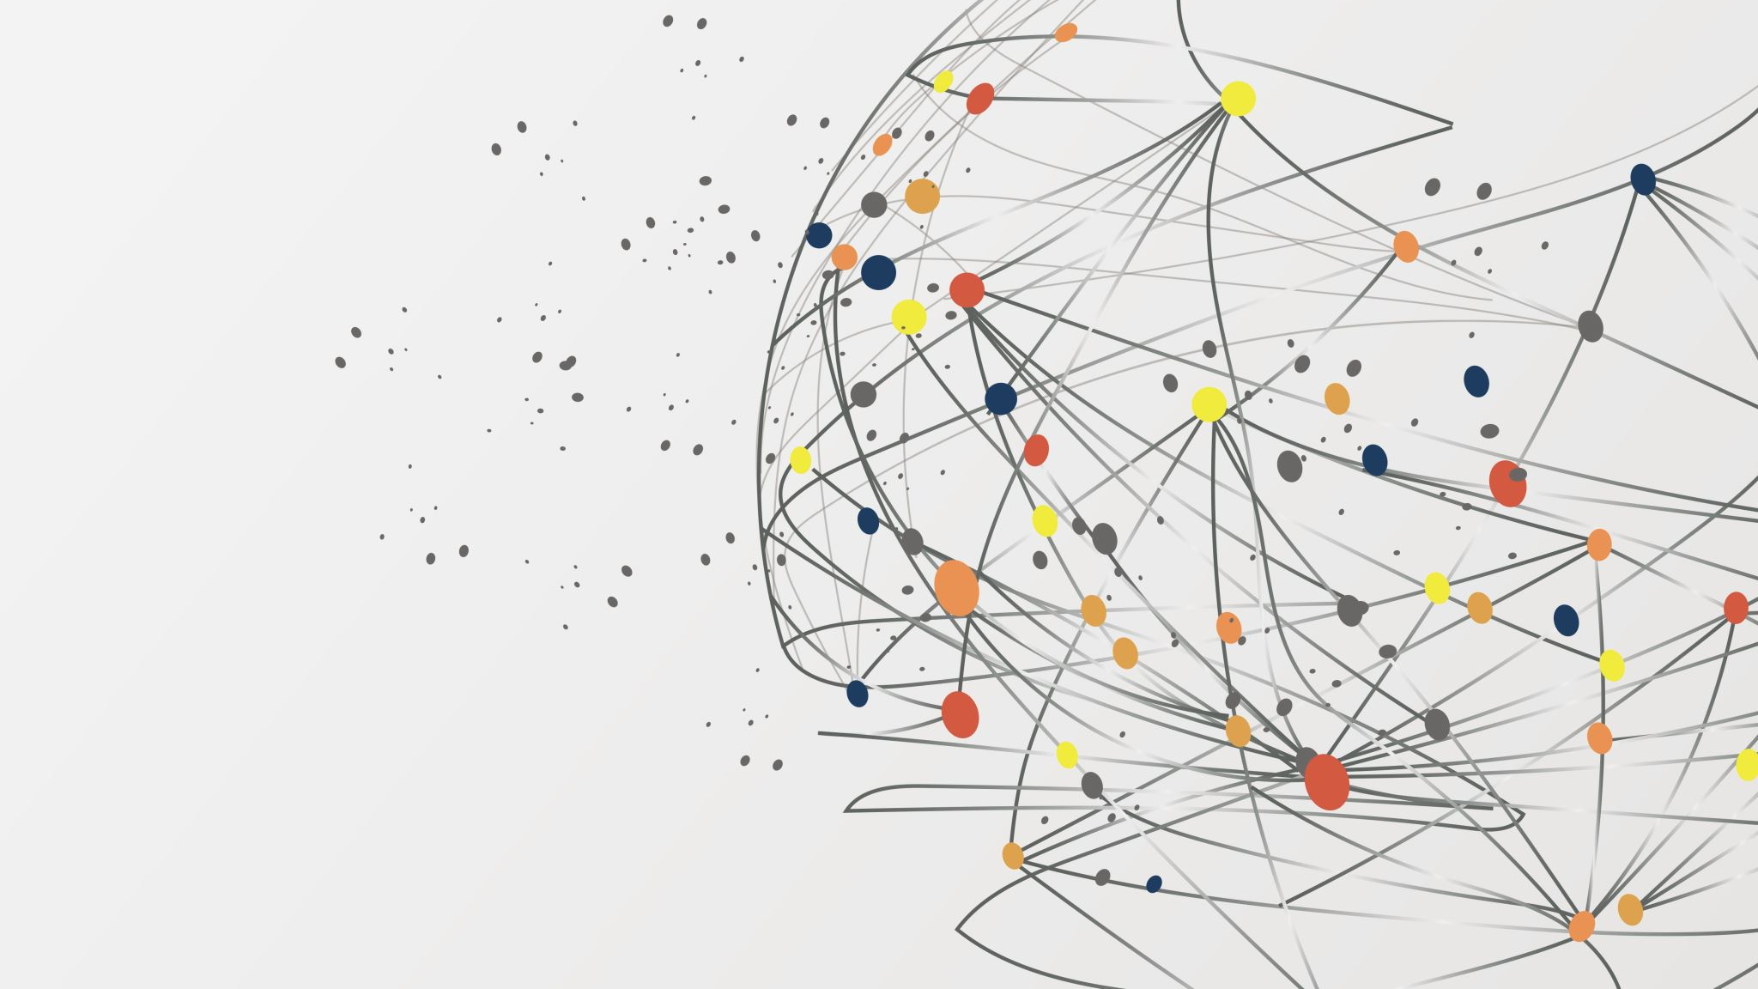
MedEN – The Medical Search Engine
Course Instructor:
Carlos E. Caicedo Bastidas
Project by:
Yash Senjaliya | Trishla Jain
Suyash Jadhav | Shaunak Edakhe

Slide 2




Aim | Objective
A ML APPLICATION THAT CAN RECOGNIZES THE RELATIONSHIP AND PATTERN BETWEEN DISTINCT TERMS USED TOGETHER IN MEDICAL SCIENCE
A SMART SEARCH ENGINE FOR RECORDS CONTAINING THOSE KEYWORDS
AN AZURE MACHINE LEARNING PIPELINE TO DEPLOY AND SCALE THE PROGRAM

Slide 3
Tech Stack
Language
Python
Packages
NLTK
Scikit-Learn Pandas
Numpy
Streamlit
Cloud
Azure App Services, Azure Data Factory, Azure Blob Storage, Azure Databricks
Code Management
Git, GitHub, Docker

Slide 4
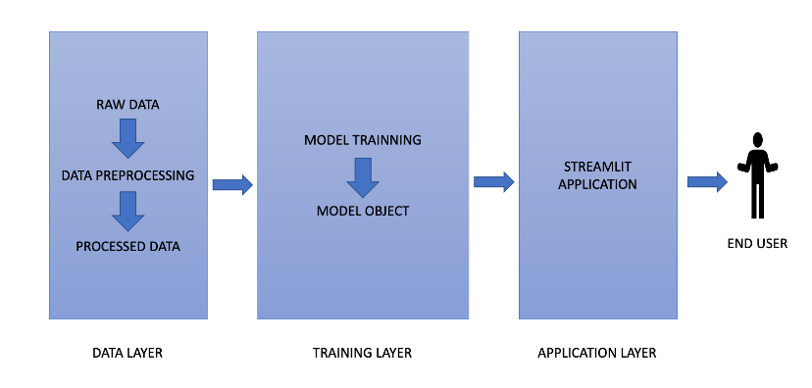
Flowchart

Slide 5
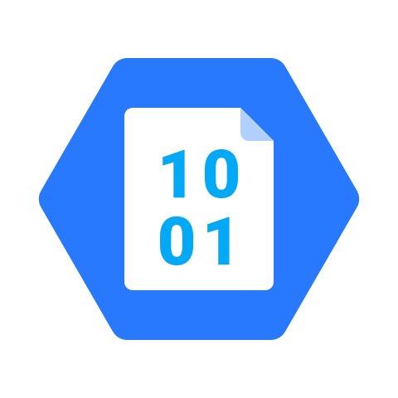
Cloud Services Architecture
1. Azure Blob Storage
• Helps create data lakes for analytics needs
• Provides storage to build powerful cloud-native and mobile apps
• Service for storing binary large objects or blobs – typically unstructured data (text, images, and videos, along with metadata)
• Stored in directory-like structures called “containers”
• Service includes:
• Blobs, which are the data objects of any type
• Containers, which wrap multiple blobs together
• Azure storage account, which contains all your Azure storage data objects

Slide 6
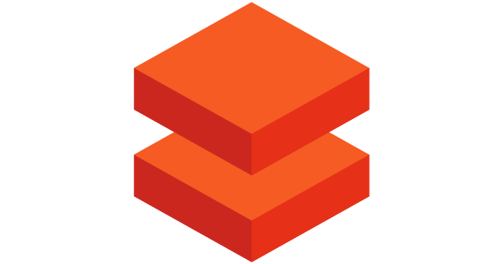
Cloud Services Architecture
2. Azure Databricks
• Provides a unified set of tools for building, deploying, sharing,
and maintaining enterprise-grade data solutions at scale.
• Integrates with cloud storage and security in your cloud account and manages and deploys cloud infrastructure on your behalf.
• Common use cases:
• Building an enterprise data Lakehouse
• ETL & Data Engineering
• Machine Learning, AI & Data Science
• Data Warehousing, Analytics, & BI
• Data Governance & Security Data Sharing
• DevOps, CI/CD
• Real-time Streaming Analytics

Slide 7

Cloud Services Architecture
3. Azure Data Factory
• A managed cloud service built for complex hybrid extract-transform-load (ETL), extract-load-transform (ELT), and data integration projects.
• Offers code-free UI and single-pane-of-glass monitoring and management.
• Lift and shift existing SSIS packages to Azure and run them with full compatibility in Data Factory.
• Used for:
• Supporting data migrations
• Getting data from a client’s server or online data to an Azure Data Lake
• Carrying out various data integration processes
• Integrating data from different ERP systems and loading it into Azure Synapse for reporting.
Notes:
A service that can orchestrate and operationalize processes to refine enormous stores of raw data into actionable business insights.
A managed cloud service that's built for complex hybrid extract-transform-load (ETL), extract-load-transform (ELT), and data integration projects.
Offers a code-free UI for intuitive authoring and single-pane-of-glass monitoring and management.
Lift and shift existing SSIS packages to Azure and run them with full compatibility in Data Factory.
Can be used for:
Supporting data migrations
Getting data from a client’s server or online data to an Azure Data Lake
Carrying out various data integration processes
Integrating data from different ERP systems and loading it into Azure Synapse for reporting.

Slide 8

Data Description
The file contains all relevant publications, datasets and clinical trials from Dimensions that are related to COVID-19. The content has been exported from Dimensions using a query in the openly accessible Dimensions application, accessible at https://covid-19.dimensions.ai/.
Dimensions Resources. (2020). Dimensions COVID-19 publications, datasets and clinical trials [Data set]. Dimensions. https://doi.org/10.6084/m9.figshare.11961063.v42

Slide 9
NLP Scripts
Functions to pre-process the data
remove URLs
convert text to lowercase
remove punctuations
tokenize words
Word2Vec Model - converts tokenized words into vector format
Cosine similarity - calculate nearest word to the query entered.
top_n function - return top 100 results based on the query entered
read_data.py
pre-processing.py
return_embed.py
top_n.py
app.py
main.py
authentication.py

Slide 10
Project Demonstration
https://drive.google.com/file/d/1qYHbDOTk2QFacGEkmV4amfZFAcPcNJjo/view?usp=share_link

Slide 11
Issues | Challenges Faced
Integration issues when mounting and authenticating Python scripts between Azure Blob Storage and Azure Databricks
Master script ‘main.py’ needed lots of ad-hoc debugging
Issues in understanding how to push the entire application with integrated cloud services, to the Docker Hub.
Crashes during UI deployment as ‘Streamlit’ package in Python was not running correctly.

Slide 12

Questions?

Slide 13
Thank you!

